Slide 1

Retail Sales Data Presentation
Micah Holmquist
5-3-2025

Slide 2
Data in Question
-Sales data for a United Kingdom based web retailer
-Sales data is from 12-1-2010 to 12-9-2011
-Retailer specializes in all-purpose gifts
-Many customers are wholesalers
-

Slide 3
Descriptive Statistics
-25,900 total orders
-Average Order: 376.36 Median Order: 207.54
-Customers come from 38 countries
-

Slide 4
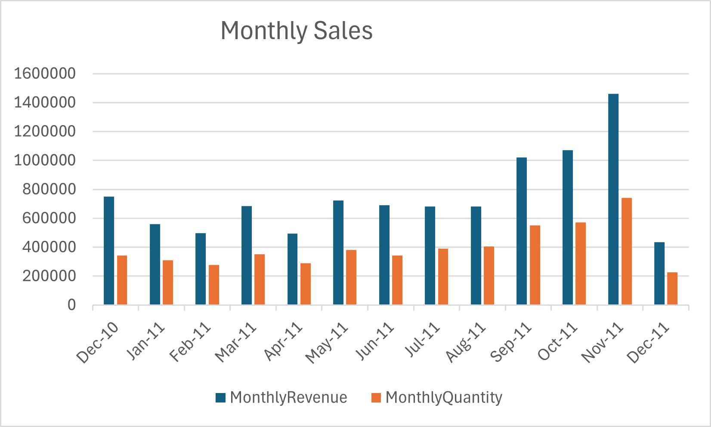
Sales by Month
Keep in mind that data is incomplete for December 2011
-Two new countries were added, but there were also five countries from which customers made orders in December 2010 but not November 2011
-

Slide 5
Takeaways
-Sales have generally increased
-Revenue was 95% greater in November 2011 than in December 2010
-Revenue is highly correlated with the quantity with the number of items sold
-Regression: Sales Revenue = 1.96 * Sales Quantity – 32,126
-This regression accounts for roughly 97% of variation in Sales Revenue
-Consequently we are going to look just at Sales Revenue
-

Slide 6
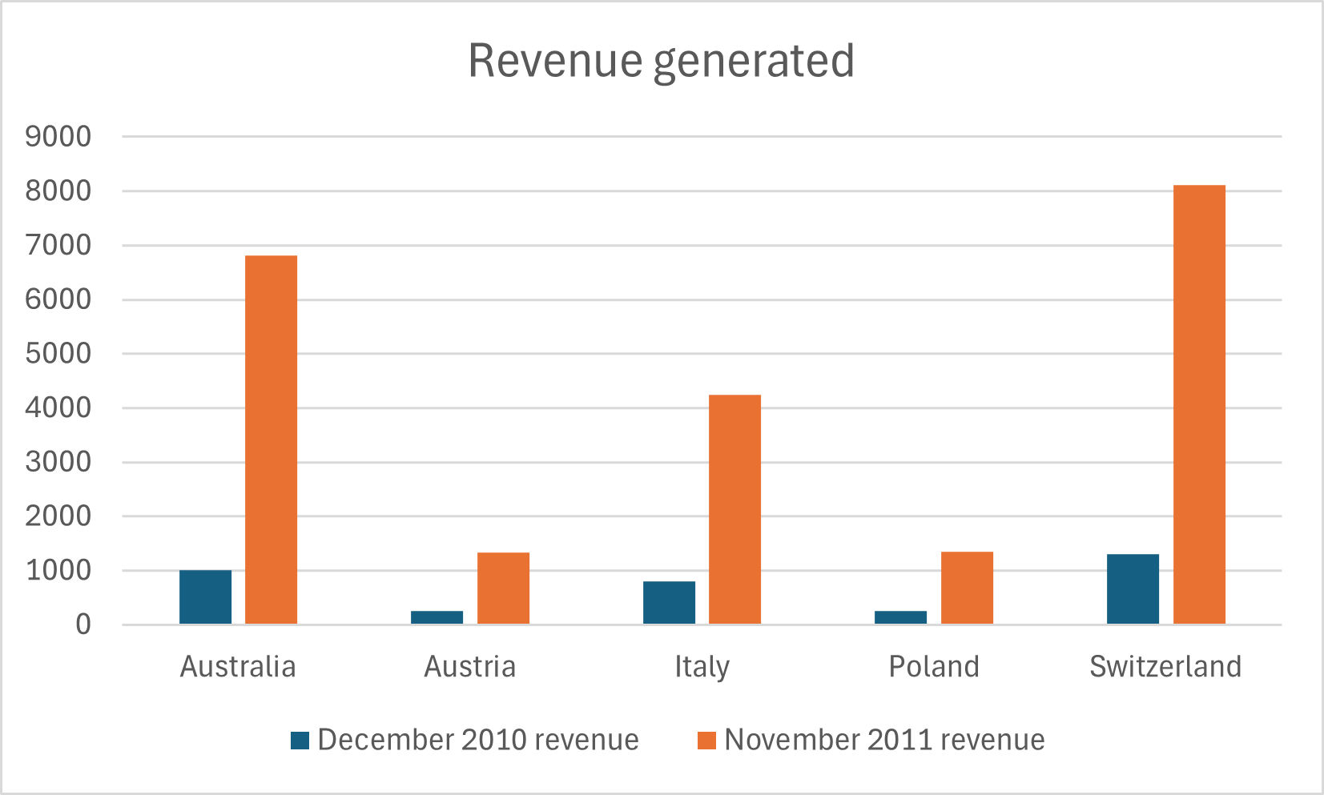
Sales to some countries experienced tremendous growth
Country | Increase in Revenue
Australia | 577%
Austria | 417%
Italy | 434%
Poland | 441%
Switzerland | 522%
-

Slide 7
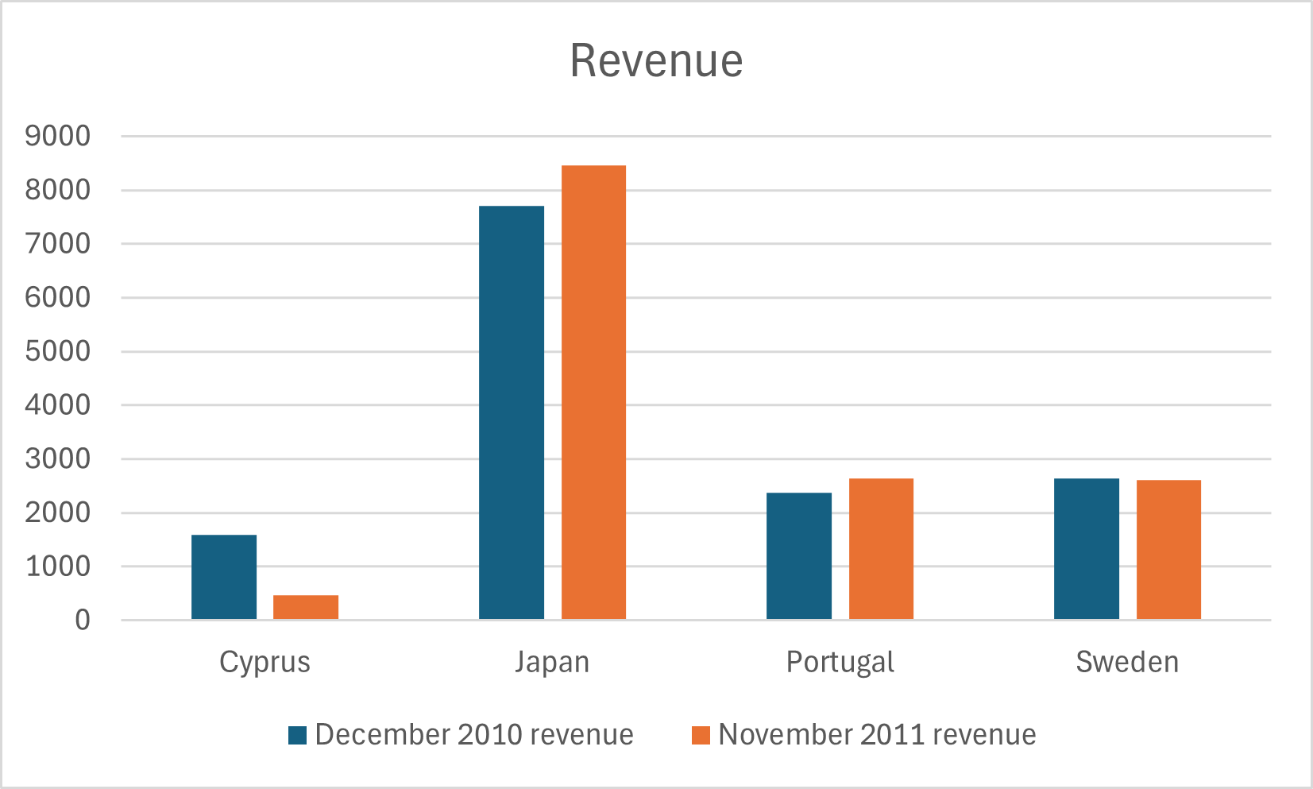
Growth was less impressive in some countries
Country | Increase in Revenue
Cyprus | -71%
Japan | 10%
Portugal | 11%
Sweden | -1%
-

Slide 8

Limitations of what we can ascertain from this data
-Limitations in the data prevent some normally standard conclusions
*We do not know what the marketing budget for each country is
*We do not know what changes, if any, were made to the website
*The timeline of data prevents looking for seasonal trends
-

Slide 9
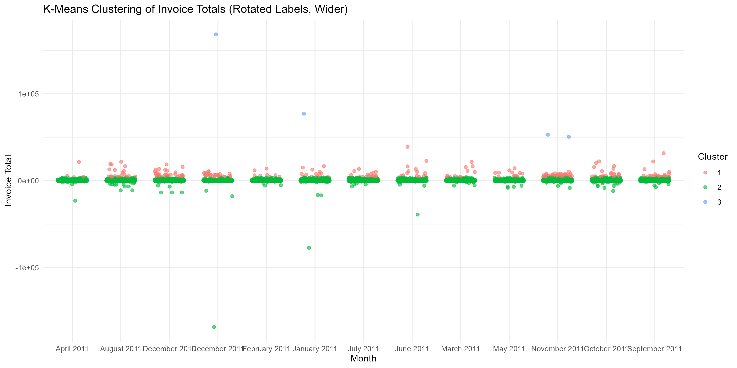
clustering
-A statistical method known as K-Means clustering was used to try to group orders by similarity
-The goal is to group order types by similarity
=Unfortunately the vast majority of orders are very similar to each other
-The major takeaway is that most orders are very similar
-

Slide 10
Recommendations
-Sales have increased tremendously but not across the board, so efforts should be made to look at higher performing markets to see if marketing campaigns used there would be applicable to other markets.
-Similarly, we should look at lower performing markets and try to identify if marketing campaigns used there are the cause of slower growth
-
-

Slide 11
Source
Chen, D. (2015). Online Retail [Dataset]. UCI Machine Learning Repository. https://doi.org/10.24432/C5BW33.
-

